Slide 1
Extended Task Resubmission
James Salazar 1269132
Mateusz Gren 1025504
Michael Lazarus 1206994

Slide 2




Algorithm
Baseline:
Extension:
1)
3)
1)
3)
2)
2)

Slide 3
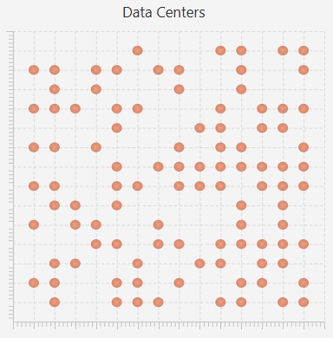
Architecture
Grid
Fixed Size
Datacenter (DC)
Randomly Distributed
Physical Machine (PM)
Fixed Number / DC
CPU, Memory, Bandwith
Virtual Machine (VM)
Shares Memory of a PM
1 Job at a Time
Job
Gaussian Distributed Execution Time

Slide 4
Implementation
Job
Single Thread Using Thread.sleep() as „Operating Time“
Probability of Failing Determined by Job & VM
Migrations
Minimize Latency
Checking for „Free“ PM in Same DC
Choosing Next DC by Comparing Bandwith
Increasing Failure Rate
After Every Job to a Given Limit
Reset to „0“ After Reboot

Slide 5
Setup
gridSize = 5
numberOfDataCenters = 10
numberOfPhysicalMachinesPerDC = 10
basicEnergyUtilization = 5
RestartDuration = 10000
Duration: 3 hours

Slide 6
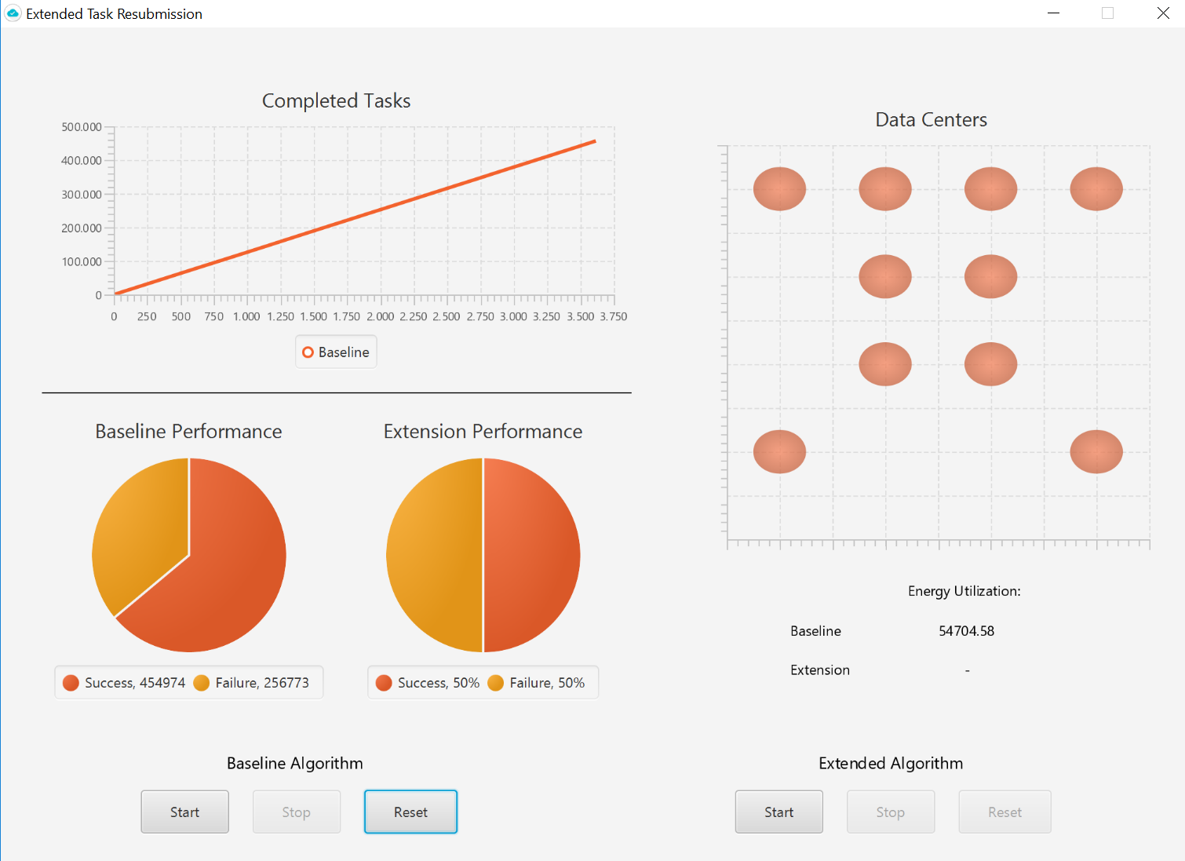

Slide 7
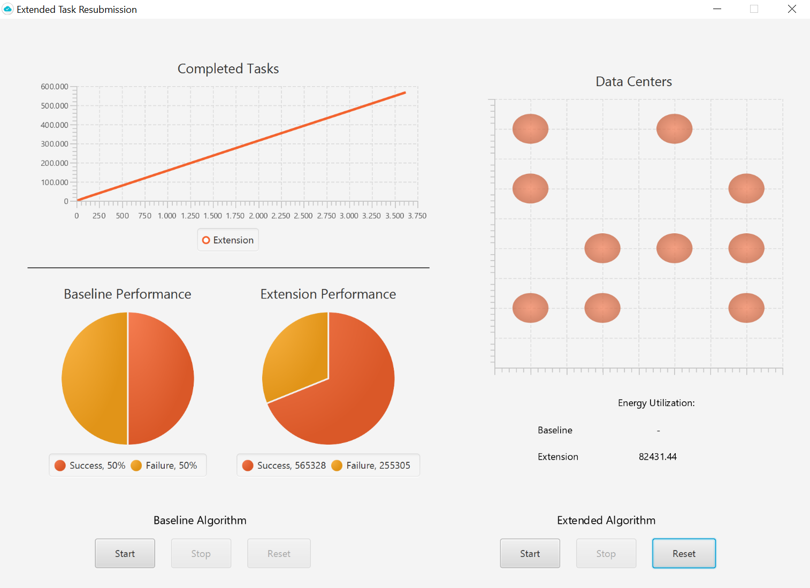

Slide 8
Conclusio
Baseline
Success-rate: ~64 %
Energy Utilization: 54705
Extension
Success-rate: ~69%
Energy Utilization: 82431
Improvement
Additional failure rate

